Slide 1

Spring Microservice Example

Slide 2
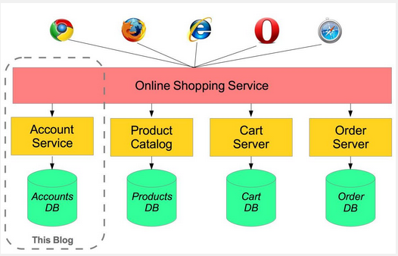
Microservices with Spring
For example imagine an online shop with separate microservices for user-accounts, product-catalog order-processing and shopping carts:

Slide 3
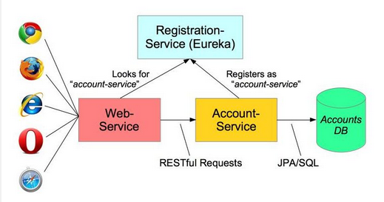
Creating a microservice for the user account service

Slide 4
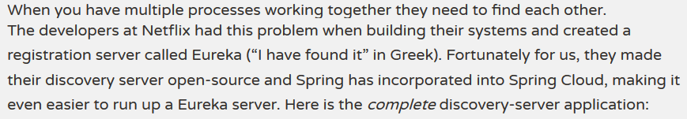
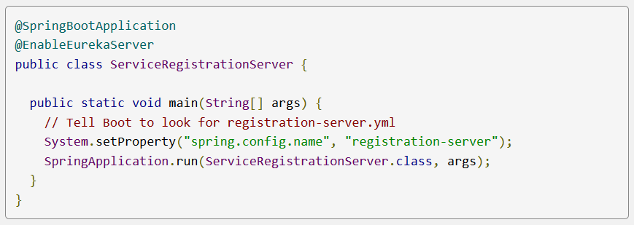
Service Registration

Slide 5
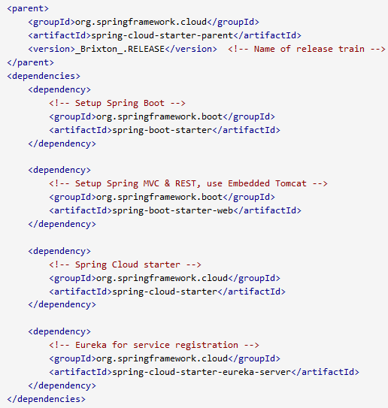
Starter dependencies
Spring Cloud is built on Spring Boot and utilizes parent and starter POMs. The important parts of the POM are:

Slide 6
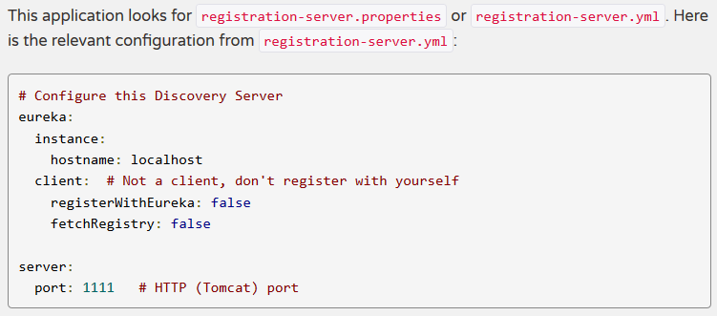
Service Registration

Slide 7
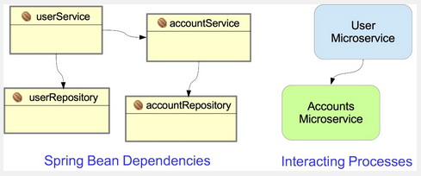
Creating a Microservice: Account-Service

Slide 8
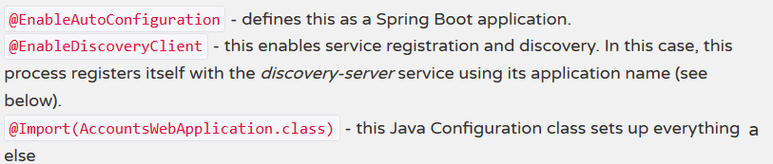
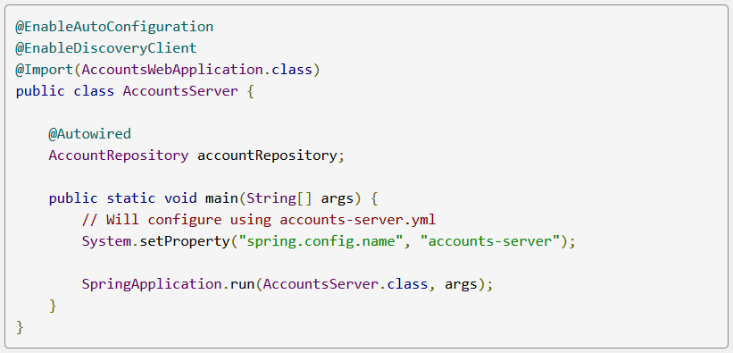
Creating a Microservice: Account-Service

Slide 9
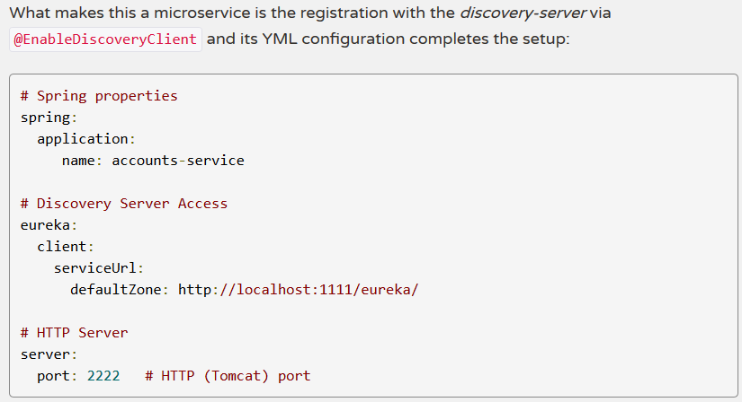
Creating a Microservice: Account-Service

Slide 10
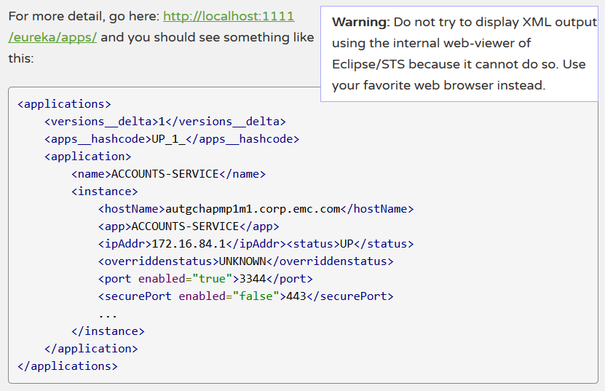
Creating a Microservice: Account-Service
Testing:

Slide 11
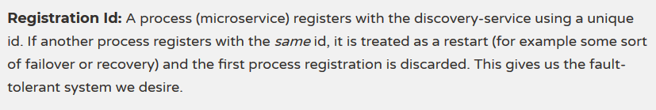
Configuration Options

Slide 12
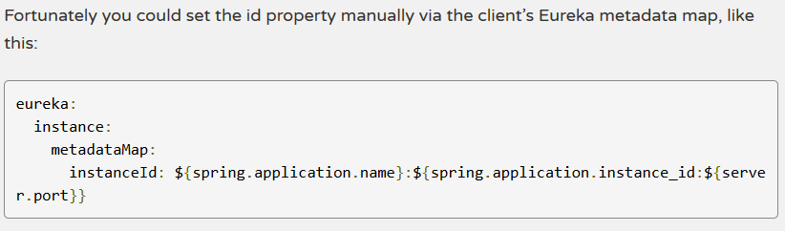
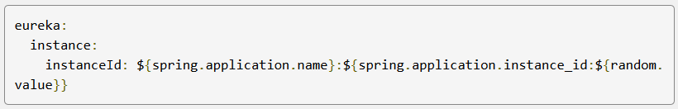
Configuration Options

Slide 13
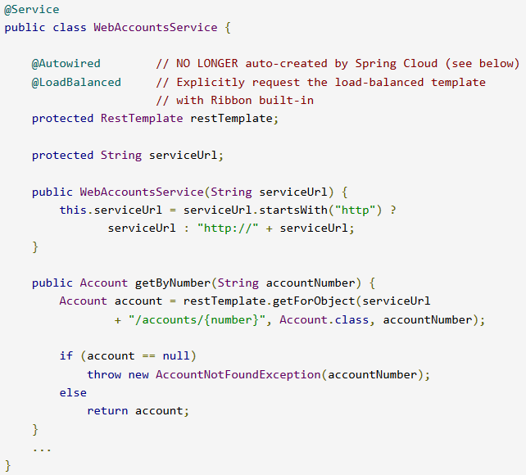
Accessing the Microservice: Web-Service
Here is part of the WebAccountService for the client application:

Slide 14
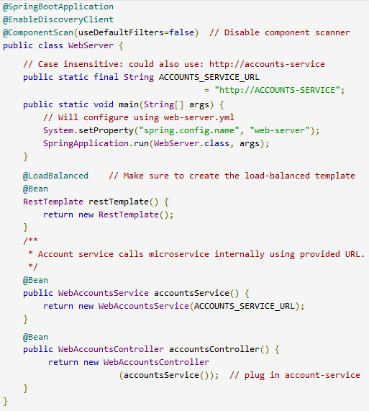
Accessing the Microservice

Slide 15
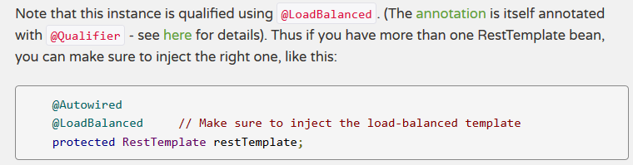
Load Balanced RestTemplate

Slide 16
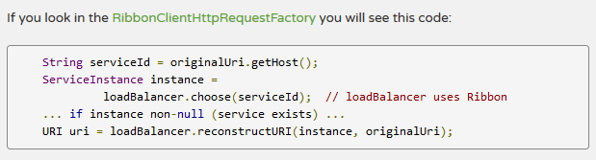
Load Balanced RestTemplate

Slide 17
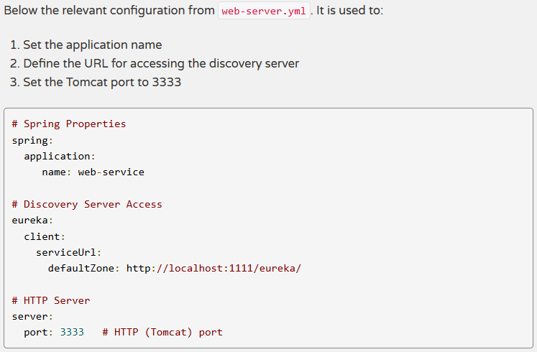
Configuration

